Slide 1

How many calories
A sustainable approach to dieting

Slide 2
Key words
Calorie
Simply a unit of energy
Maintenance calories
Exactly what is sounds like. The number of calories required to in a given day to maintain your weight
Calorie Deficit
When you consume less calories than to maintain your bodyweight
By definition, produce weight loss ( hopefully body fat loss)
Means you’re using more energy than you’re taking in via eating food
In order to lose fat ( with context) you need to be in a deficit
Calorie Surplus
When you consume more calories than to maintain your bodyweight
The usual goal in a surplus it to put on LBM ( lean body mass) and not fat tissue

Slide 3
Key words
Metabolism
The entirety of your body’s chemical processes
Two big ones bing the processes breaking down or building up the matter inside of us
Catabolism is the breaking down of larger molecules into smaller molecules and anabolism is the building of larger molecules or structures from smaller molecules
Metabolic adaptation
The change in metabolic rate as an adjustment to your intake
When you lose weight and were losing for a while, and you stalled. You have witnessed metabolic adaptation
When you consumed fewer calories than your maintenance your metabolism adapts by slowing down to prevent too much weight loss
Basically the self defense system we spoke about in earlier class

Slide 4
How much should I eat to lose fat?

Slide 5
IT DEPENDS
Any diet work as long as a calorie deficit is created
Our goal is just not weight loss
Increased weight loss is not due to the property of food
Its that foods macronutrients composition
Protein is 4 calories per gram, Carbohydrate is 4 and fat is 9 calories
Protein has higher TEF so it is better for fat loss
There is no food that is energy negative or free foods
Some foods may be better than other and have higher TEF

Slide 6
Determining your maintenance calories
“ TDEE = BMR + NEAT + Exercise + TEF”
Several popular calculators
Some are better than others but all of them are just estimates
You will still get the same basic range from each
Never 100% accurate
I Prefer the Muller equation ( tested in modern pop and accounts for LBM and fat intake)
Fat mass (FM) = bodyweight * body fat %
Lean body mass(LBM) = Body mass - Fat mass

Slide 7
Why measure body fat?
LBM is metabolically active tissue than FM
Contributes significantly more to TDEE
LBM isn't solely your muscle pass
Muscle mass is part of LBM
Includes organs, hair, fluids, bones, connective tissues anything that isnt composed of fat
Therefore when you lose LBM you are not losing all muscle
Numbers on the scale will fluctuate
Losing body weight does not equal losing body fat. That is why we need to look at fat %
More data always allows you to make better more accurate decisions

Slide 8
Ways to measure fat
Skin calipers
BIA .( bioelectrical impedance analysis)
handheld device that sends electric currents through your body to measure body fat
Some weight scales can do this now
Dexa scan
Uses low level xray to determine bf
Underwater weighing
Since muscle is more dense than fat ( muscle sinks fat floats) they can use this as approximate the percentage of BF
Old school navy fat measurement
Based off age, sex, as well as your waist, hip and neck measurement

Slide 9
Which method? How often?
Some methods are more accurate than others
None of them are accurate
Which method you use is less important. Consistency is most important
Make sure your method is repeatable and convenient
Measure it in the same time of day every time with no food/water
When on a diet your BW fluctuates a lot
1% from day to day is quite common
Some even 2%
If you’re a woman, your menstrual cycle can yield different weight
The amount of salt you ate in comparison to the amount of water you drank can affect the next days weigh in
Food choices can also affect your weight in

Slide 10
Recommendation
My recommendation is calipers
Easily available
Reliable if done correctly/ at least the same way
Weight fluctuates from day to day
Take weekly averages by measuring daily
Week 1 ; 80.2,79.5,80.0,81.4,80.6,80.2,79.2 = weekly average 80.2
Week 2 ; 79.1,78.8,78.5,78.1,78.5,78.7,80.0 = weekly average 78.2
Should you take body fat measurements everyday?
NO, maybe once a week/month
To measure progress in cut or bulk.
3 fold test and take the average of the 3

Slide 11
Summary
Be consistent with your measurements
Pick one type of measurement that you can easily do and stick with it
Be aware that your scale weight and LBM will fluctuate
Remember that 100% accuracy in measurement is impossible, but spotting trends is guaranteed if you measure consistently

Slide 12
Muller Equation
“ (13.587*LBM)+(9.613*FM)+(198*Sex)-(3.351*Age) + 674 = BMR
1 for male and 0 for female
Let’s assume our hypothetical subject is 75 kgs and say he has 15% BF 25 years old.
LBM = BW - FM
LBM = 75 - 11.25 = 63.75
The man
(13.587*63.75)+(9.613*11.25)+(198*1)-(3.351*25) + 674 = 1762.5 BMR
And for a woman who has 9% BF at 60 kgs and 37 years old?

Slide 13
Muller Equation
These are not accurate.
We can get a similar ballpark with all the other calculators too
The equation will only work for 60% of people
They will work okay for 20-30% people
And won't work well for 10-20% people
ONLY ESTIMATES!
Muller is our favourite because it accounts for LBM and FM and LBM is a major contributor to metabolic rate
Others are not garbage either!
Need to be consistent

Slide 14
Activity Factor
Once BMR is sorted out . it is time to figure out our maintenance calories
We add this to our BMR and add in calories you burn when you exercise or play sports or your activity levels
This figure is gonna be higher than your BMR and is based on a range starting 1.2 all the way up to 1.9

Slide 15
Multiply with
1.2 ( Sedentary)
You work a desk job and don't exercise
1.375 ( Light Activity)
You work a desk job but do a bit of regular exercise. Or you don't exercise but you work at a job that’s pretty active ( a nurse, teacher,etc) where you are on your feet most of the day
1.55 ( Moderate activity)
Most would fall in this category. Maybe you work a sedentary job, but you train like a madman, Or you train moderately , but you have a job you stand on your feet all the time OR someone who doesn't train but works a hard labor job would also fall in this
1.725 ( Very Active)
You train hard most days of the week, and you also have a job where you’re on your feet quite a bit. Overall, you’re active most of the day
1.9 ( Extra Active)
You train hard and work a job that is physically demanding in nature. A example you work in construction or are a roofer and also goes to the gym five days a week

Slide 16
Calculating BMR with activity level
BMR * Activity level
If you are moderately active
Our hypothetical man comes to around
1762 * 1.55 = 2731
There are newer versions of the calculator none are accurate
IF YOU ATE 500 CALORIES LOWER THAN YOUR MAINTENANCE AND DID NOT LOSE WEIGHT IT IS NOT 500 LOWER THAN YOUR MAINTENANCE

Slide 17
The Best Method : Trial and error
Ideally you would spend several weeks at your maintenance calories to see if you actually do maintain
If your goal is to lose fat, then you want to tighten up the margin of variance everytime you weigh in.
+- 1% body weight is normal weight fluctuations
I recommend weighing in the morning upon waking up after using the bathroom every single day and take out an average.
Based on how much you gain or lose on a certain amount of calorie amount, you can get a pretty good idea of what your maintenance is.
For example our sample was consuming 2730 calories a day for four weeks and you lost 1Kg of fat in that time period, you can use that data to calculate approx maintenance calories

Slide 18
Determining changes in Body fat vs LBM
Did our 75 kg man lose all BF only?
That means he lost 100% lipid - but body fat is not 100% Lipid
About 87% lipid . So if we take 1000 grams (1Kg = 1000g) * .87 we get 870 grams of actual lipid lost.
We know 1 gram of fat = 9 calories
So our sample lost 870 * 9 calories = 7830 calories
We lost this in 28 days . So 7830 calories /28 days to get 280 calorie per day
Add back 2730 + 280 calories = 3010 calories is his maintenance

Slide 19
What about weight gain?
Let's say we ate 3600 calories per day and put on 2.5 KG with ¼ being LBM
2.5 * .25 = .625kg lean body mass
2.5 * .75 = 1.875 kg body fat
Lean mass is not 100% protein
Mostly fluid
70% of LBM is fluid
30% is approximately lean tissue, most withg is made out of protein
SO, if we take .625 LBM * .3 = 0.1875 kg of protein * 1000 g = 187.5 gm of protein
One gram of protein is 4 calories
187.5 * 4 = 750 calorie from LBM
Back to calories from body fat. 1.875 * 0.87 = 1.63125 kg of fat
1.63125* 9 calories = 14681 calories from body fat
Total surplus = 14681 + 750 = 15421/28 days = 551 calorie surplus
Maintenance = 3600 - 551 = 3049

Slide 20
Summary
It requires you to track your weight, body fat, lean body mass and caloric intake
The most accurate way of tracking maintenance calories
If you wanna track but not go this length, you can assume approx 7000 calories in each kilogram of mass or 3500 calories in each pound of mass and make your calculation based on that
You can use any method . accurate one or rough estimate.
It is about the starting point and how you make changes over the long term
Be consistent.

Slide 21
How fast should i lose fat?
Highly debated topic!
Mostly recommended by professionals is 1200 calories especially for obese individuals is fast and rapid
Increased motivation and adherence
This is short sighted and i don't agree with this
Weight regain is a bigger problem
If you can't sustain it you cannot maintain your weight
If we start 1200 kcals we hit metabolic adaptations than what's next 900 kcals ?
Physical health aside, can you imagine how awful would it be going out with friends, dates,weddings on 900 cals a day
Losing weight faster will risk losing LBM too
Losses in LBM will increase the likelihood of weight regain and long term lower metabolic health
I recommend focus on sustainability and sparing maximum LBM

Slide 22
Recommendations
I recommended losing no more than 1% of total BW per week
Might not sound a lot but this is a very aggressive weight loss
There was a study in a natural bodybuilding prep case study
They saw significant reductions in LBM ( 42.8% of weight loss from LBM) even at 1% a week
In General the slower you can go the better it probably is
Slow doesn't mean no movement
I recommend 0.4% to 0.8% a week
This will reduce mental fatigue of dieting

Slide 23
Example
100 kgs male and we decide to lose a conservative 0.6% a week
This puts us at .60 kgs a week (also 600 grams)
He is 20% BF that puts us at 80 kgs LBM and 20 kgs FM
He wants to diet down to 10%
Simple right ? 10kgs FM loss / .6 kg a week = 16.7 weeks round up to 17?
It would be nice to assume all weight loss comes from fat mass
NOT THE CASE
Most people when dieting based on most research shows 60-70% is from Fat mass and 30-40% is from LBM
Increasing protein intake and exercising can shift it towards a slightly positive trend. Closer to 80-85% from Fat mass and 15-20% from LBM
Resistance training and high protein intake is important

Slide 24
Example
Considering out 100 kg subject does high protein and resistance training
Safe to assume he will probably lose 80% from FM and 20% from LBM
If his goal is to lose 10kg from his absolute Fat mass
If 80% of his weight loss is FM we can take
10kg ( fat to lose ) / .8 = 12.5 kgs. need to lose in order to lose 10 kgs fat so he will lose 2.5 kgs in LBM
We can say it will take him 12.5/0.6 kgs =20.8 weeks or 21 weeks ( round up)
Easy right?
Studies have shown that there is always gonna be a variance to LBM and FM
It depends on the individual
No clear cut answer but where is a general rule we can follow

Slide 25
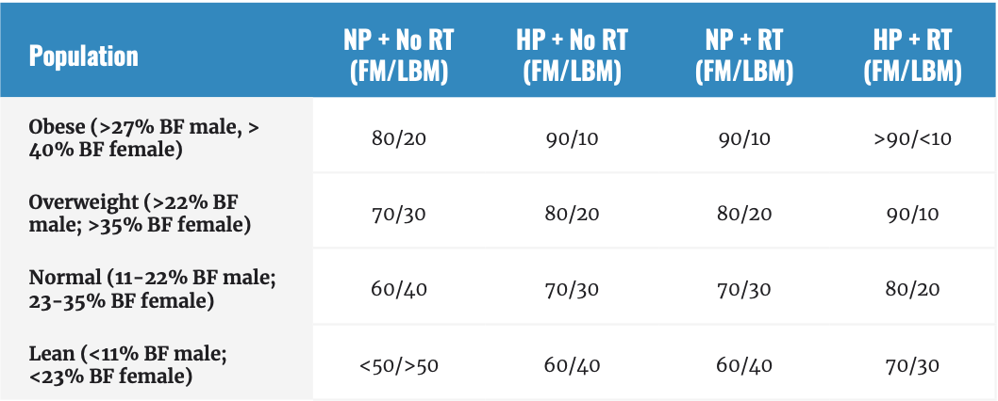
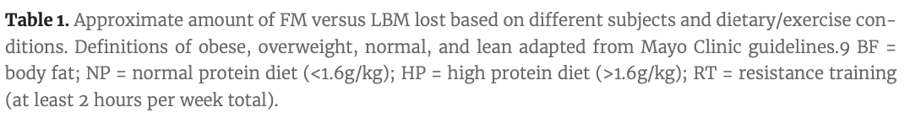
Approximates in FM and LBM

Slide 26
Make room for Life
Even the best laid out plans are subject to chaos of life
Life will happen
Number of stressful events occur all the time
Trust me nobody gives a damn about your diet
More reason to use a sustainable approach
When life is good, it’s easier to focus on little things to improve ourselves
It is when life takes a nosedive to the shitter that our will power for things like dieting goes into the tank
“ Self control is fatiguing”
Why would you not take the the approach that requires the least self control ?

Slide 27
Make room for life
Your odds are higher if you can remain adherent even when things are stressful
Not for me to decide what will work best for you
This is why i'm providing you with all the information to set up for success in the long term
Give yourself more time to lose weight
Choose the types of food you enjoy eating within the constraints
Pack ahead of time
Understandable that you may have a high stress life and you are in a stressful situation.
Completely unrelated to the diet itself
Hope for the best prepare for the worst
You can hold steady if you hit your goal early or even to start adding calories in but it is way more difficult to play catch up if you get behind!

Slide 28
Determining your caloric deficit
Your caloric deficit refers to the amount of calories you consume below your maintenance calories.
Daily calorie target = maintenance calories - Deficit calories
This will be based on the percentage of calories you wish to lose per week
Our Preference? 0.4% - 0.8 % per week with the maximum of 1%
Let's bring back our 100 kg guy
Target 0.6% weight loss per week ( 100 kg* 0.6 = 600g per week)
We can use this as information to determine his deficit calories
Based on our scientific data. We can estimate he will lose around 80% of his weight from FM and 20% from LBM.
On a weekly basis we need to lose 480 grams from FM and 120 grams from LBM

Slide 29
Determining your caloric deficit
First we can calculate how many calories would come from FM lost
Calories from fat loss would equal 480 g body fat * 0.87% lipid in body fat = 417.6 g (roundup to 418) of fat
418 * 9 calories /g of fat = 3762 calories from FM
Then to determine how many calories would come from LBM
120 g LBM * 0.3 = 36 gram of protein * 4 calorie/g protein = 114 calories from LBM
Therefore, the approximate total amount of caloric deficit required to lose .6 kilograms per week form him is 3762 + 144 = 3906 calories
Divide that by 7 we get out daily caloric deficit
3906/7 = 558 ( rounded) caloric deficit per day

Slide 30
SUMMARY
Always take life into account
Don't be alarmed when your body acts like something other than a math equation
Figure out your maintenance calories using one of many equations
Be consistent with your equations
Figure out how long your diet needs to be
Figure out how aggressive you want to be
START!!!!!!!!!!!!!

Slide 31
Case study
Women who is 90 kgs
36% BF
She wants to be 20% BF ( lose 16% body fat) 36 - 20%
LBM ?
FM ?
How much does she have to lose from FM ? to be about 20%
She plans to resistance train with a high protein diet
She wants to lose 1% of BW a week …
Approximately how many weeks of dieting will she require?

Slide 32
Case study
Continue From our 90 kg women
90 kg woman with 9 kilogram of body fat to lose
Target to lose 1% body weight a week
How many calories does she need to cut per week/ per day to achieve this result?

Slide 33
Case study answer
BW = 90 Fat mass = 32.4 kgs LBM = 57.6
She needs to lose 14.4 Kg of FM ( 16/36 = 0.44 * 32.4 kgs = 14.4 kgs)
To be around 20% BF
Assuming the 90/10 split
She needs to lose 14.4 / 0.9 ( actually %) ( 10% LBM lost) = 16 kgs to lose 14.4 % of fat
Choosing to lose 1% of her BW a week which is 0.9 kgs ( 900 grams)
16/0.9 = 17. 8 weeks
Round up to 18 weeks

Slide 34
Answer case study
Total bw to lose per week = 1% of 90 kgs
900 gram
900 gram weight loss per week *90% = 810g FM loss per week ( based on table)
900 gram weight loss per week * 10% = 90 g LBM loss per week ( based on table)
Now we calculate how many calories come from body fat lost
Cals from fat loss 810 g FM * 0.87% (lipids in FM)= 704.7 g
705 * 9 cals = 6345 calories from FM
Then to determine from LBM
90g LBM = 30% (lean mass in LBM) .3 = 27 gram of protein
27g * 4 cals = 108 calories
Total calories = 6345 + 108 = 6453 per week
Daily calorie deficit needed = 6453/7 =922 per day!

